Slide 1
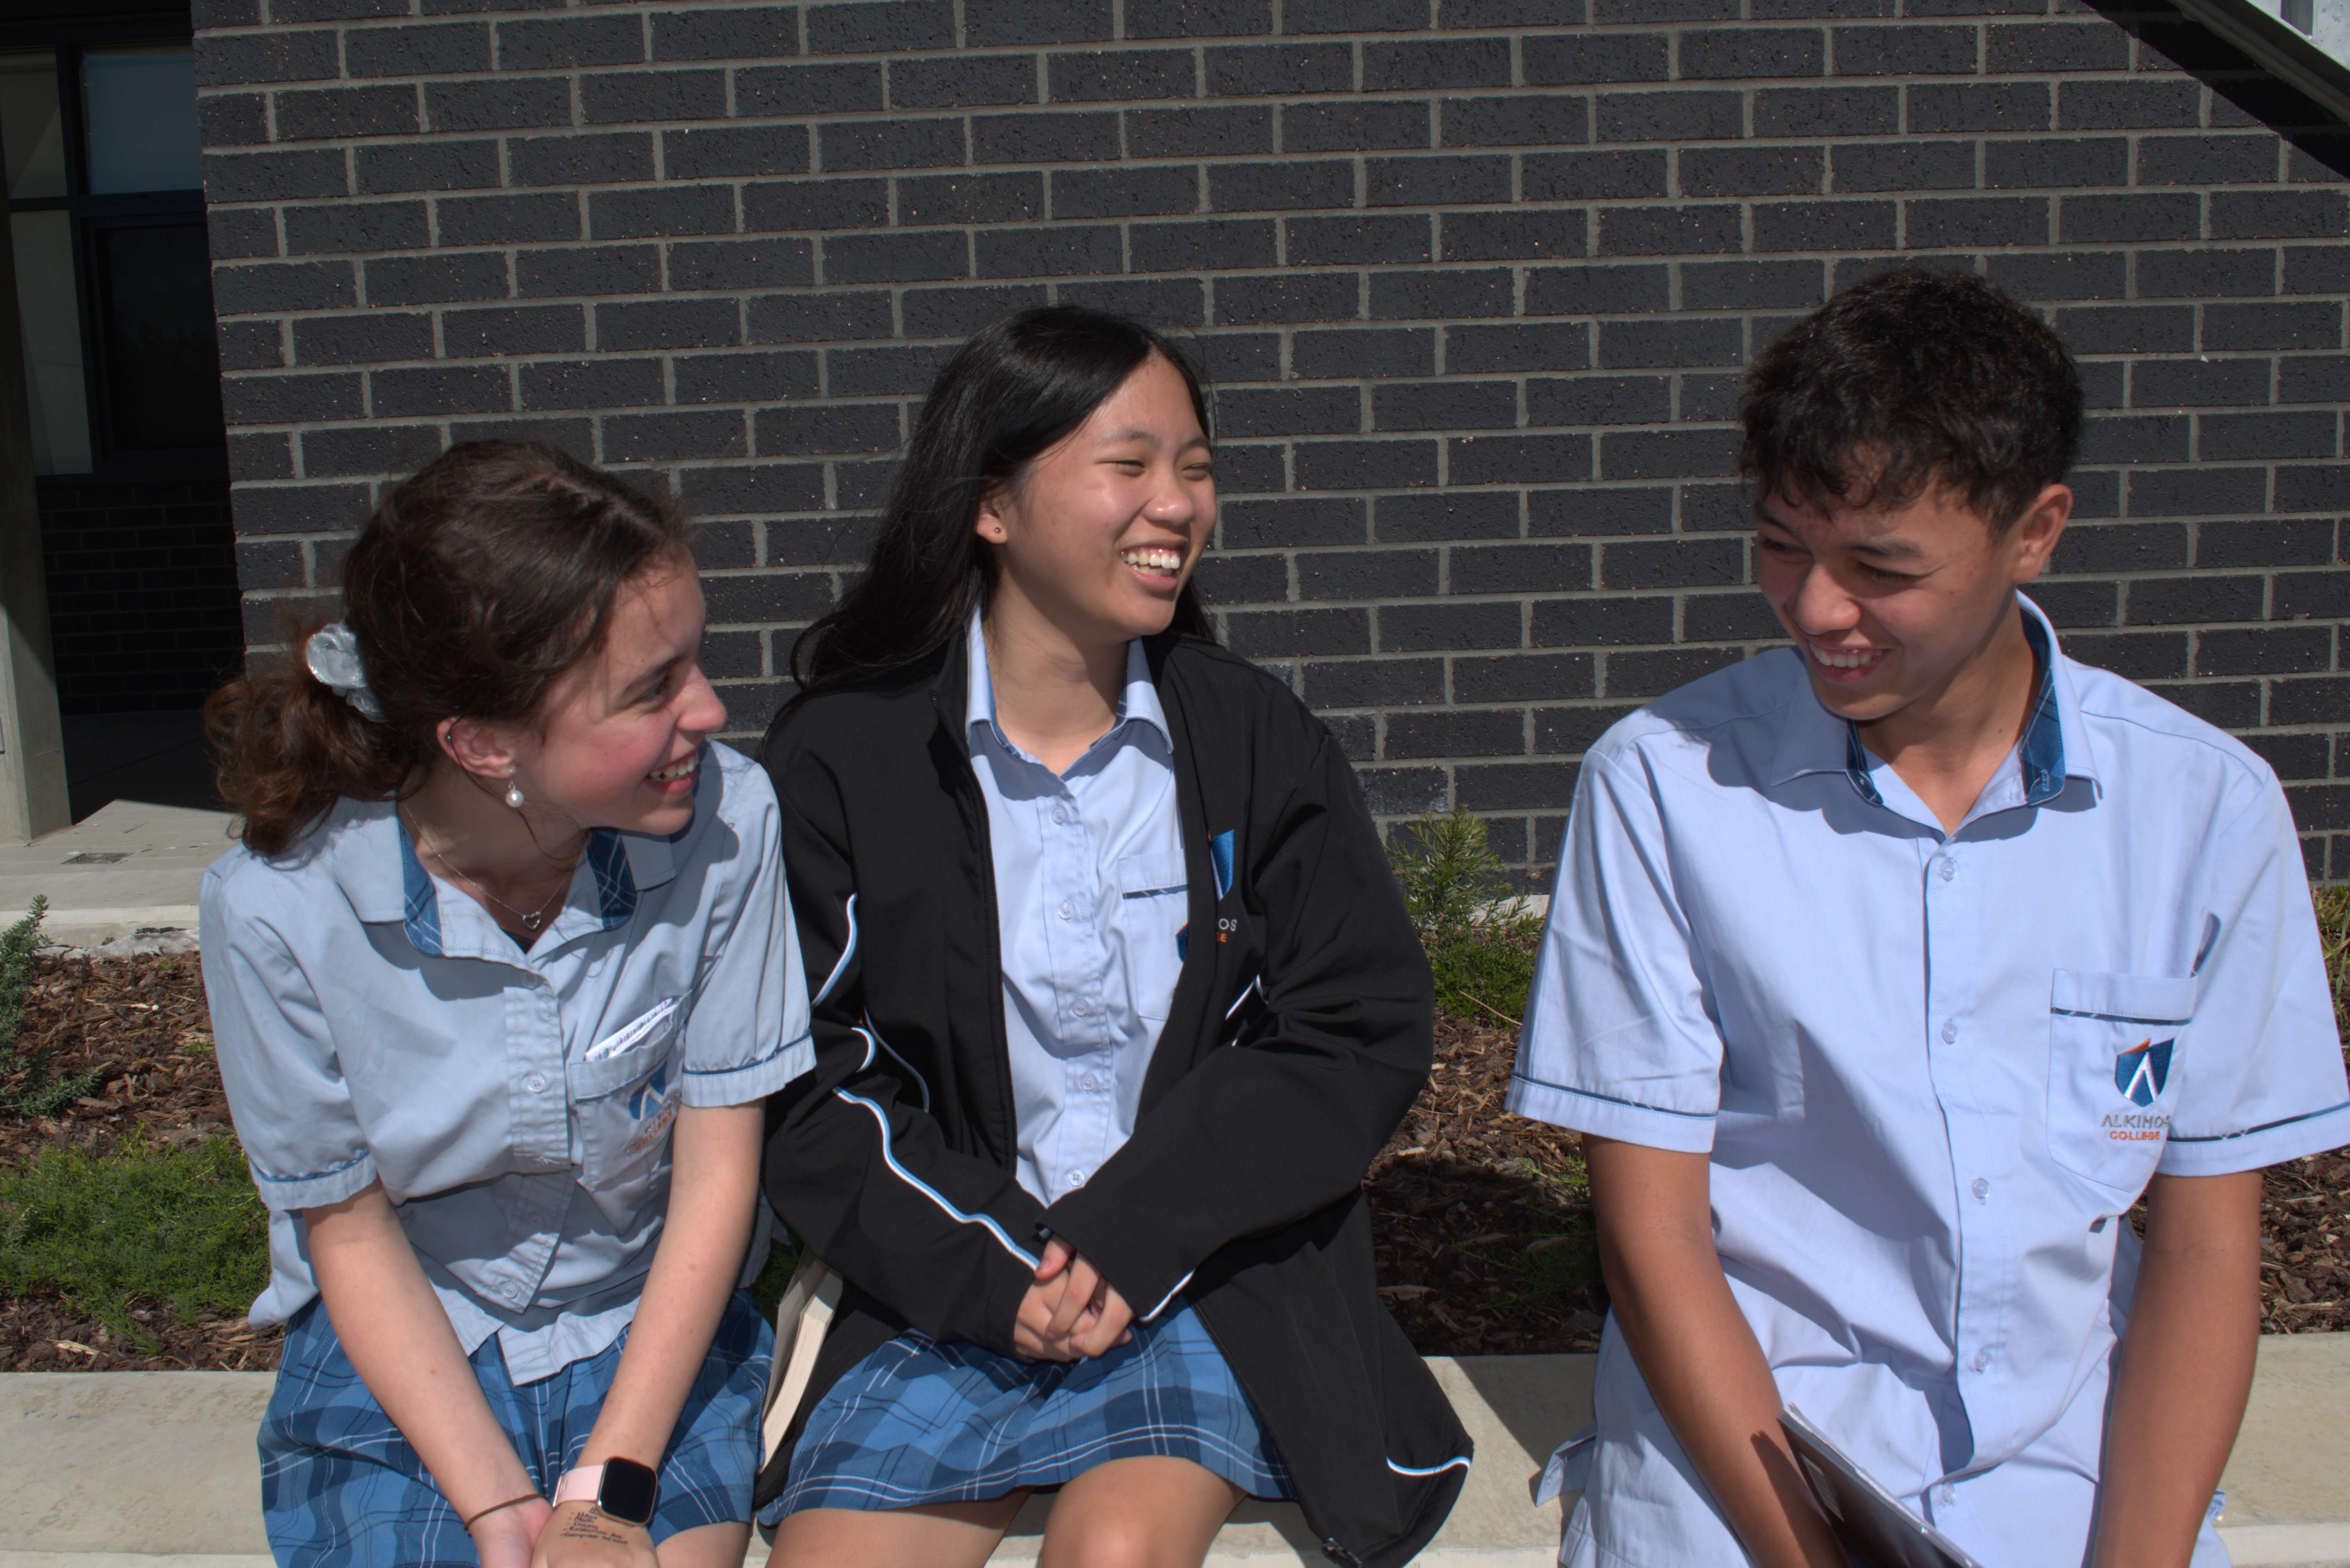
Year 12 in 2026
Information for 2024 Year 10 Students and their Parents
2023/20339

Slide 2
Guide to key abbreviations
Abbreviation | Full term
ATAR | Australian Tertiary Admission Rank
OLNA | Online Literacy and Numeracy Assessment
the Authority | School Curriculum and Standards Authority
TISC | Tertiary Institutions Service Centre
VET | Vocational Education and Training
WACE | Western Australian Certificate of Education
WASSA | Western Australian Statement of Student Achievement
WASN | Western Australian student number

Slide 3
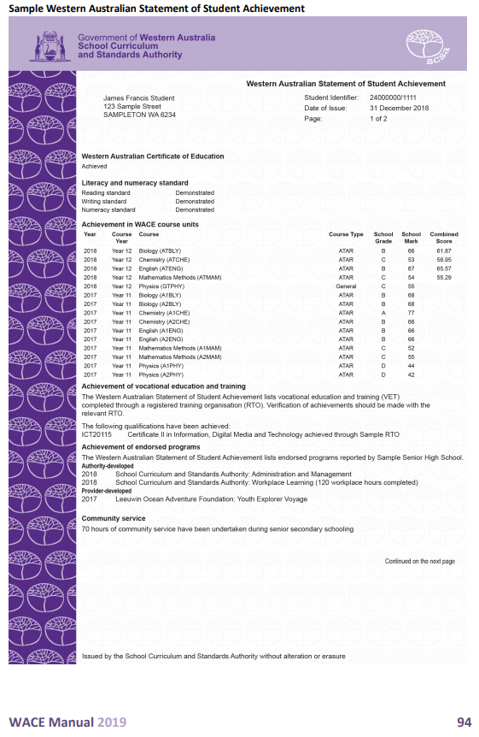
The WASSA – All students
All students receive a Western Australian Statement of Student Achievement (WASSA) when they complete Year 12.
The WASSA:
formally records a student’s achievement in every course, qualification and program that the student has completed in senior secondary schooling
provides evidence of achievement.
Notes:
The WASSA is not the same as the Western Australian Certificate of Education (WACE).
As a record of student achievement, it lists as appropriate:
achievement of WACE requirements
achievement of literacy (reading and writing) standard
achievement of numeracy standard
achievement of exhibitions and awards
school grades, school marks, and combined scores in ATAR units
school grades and school marks in General and Foundation units
completed Preliminary units
completed VET industry specific units
successfully completed VET qualifications and VET units of competency
successfully completed endorsed programs
number of community service hours undertaken (if reported by the school).

Slide 4
The WACE
The Western Australian Certificate of Education (WACE) is awarded to students who have successfully completed senior secondary schooling in WACE studies and have met the WACE requirements.
The majority of students in Western Australia achieve the WACE.
Study towards the WACE can be undertaken over a lifetime.
Notes:
The WACE is recognised nationally by universities and other tertiary institutions, industry and training providers.

Slide 5
WACE requirements
Students must:
complete one of three course combination options
complete at least four Year 12 ATAR courses* OR
complete at least five Year 12 General courses and/or ATAR courses or equivalent OR
complete a Certificate II (or higher) VET qualification in combination with ATAR or General courses
demonstrate the literacy and numeracy standards
meet the requirements for breadth and depth of study
meet the achievement standard.

Slide 6
Literacy and numeracy standard requirement
Students must demonstrate minimum standards of literacy and numeracy by either:
demonstrating the standard through the Online Literacy and Numeracy Assessment (OLNA); or
pre-qualifying in reading, writing and numeracy in their Year 9 NAPLAN and being exempted from that component in the OLNA.
2024 OLNA Year 10
10 June to 21 June
Notes:
If students do not meet the literacy and numeracy standard by the time they exit secondary school, they can apply to the Authority to re-sit the assessment.
If students do not demonstrate the required standard, they will not be eligible for a WACE.
All students receive a Western Australian Statement of Student Achievement (WASSA), which records every course and program a student has completed in Years 11 and 12.
If students demonstrate the required minimum standard after they have left school, they will be awarded the WACE (assuming they have met all other WACE requirements).

Slide 7
Breadth and depth requirement
Students must complete a minimum of 20 units or the equivalent, including:
a minimum of ten Year 12 units or the equivalent
four units from an English learning area course, post-Year 10, including at least one pair of Year 12 units from an English learning area course
one pair of Year 12 units from List A
one pair of Year 12 units from List B.
Notes:
Students must complete a minimum of 20 units or the equivalent, including:
a minimum of ten Year 12 units or the equivalent
four units from an English learning area course, post-Year 10, including at least one pair of Year 12 units from an English learning area course (English, Literature, English as an Additional Language or Dialect)
one pair of Year 12 units from List A (arts/languages/social sciences)
one pair of Year 12 units from List B (mathematics/science/technology).
The breadth requirement can be met through ATAR, General and Foundation courses.
The depth requirement can be met through ATAR, General, VET industry specific and Foundation courses, VET credit transfer and endorsed programs.

Slide 8
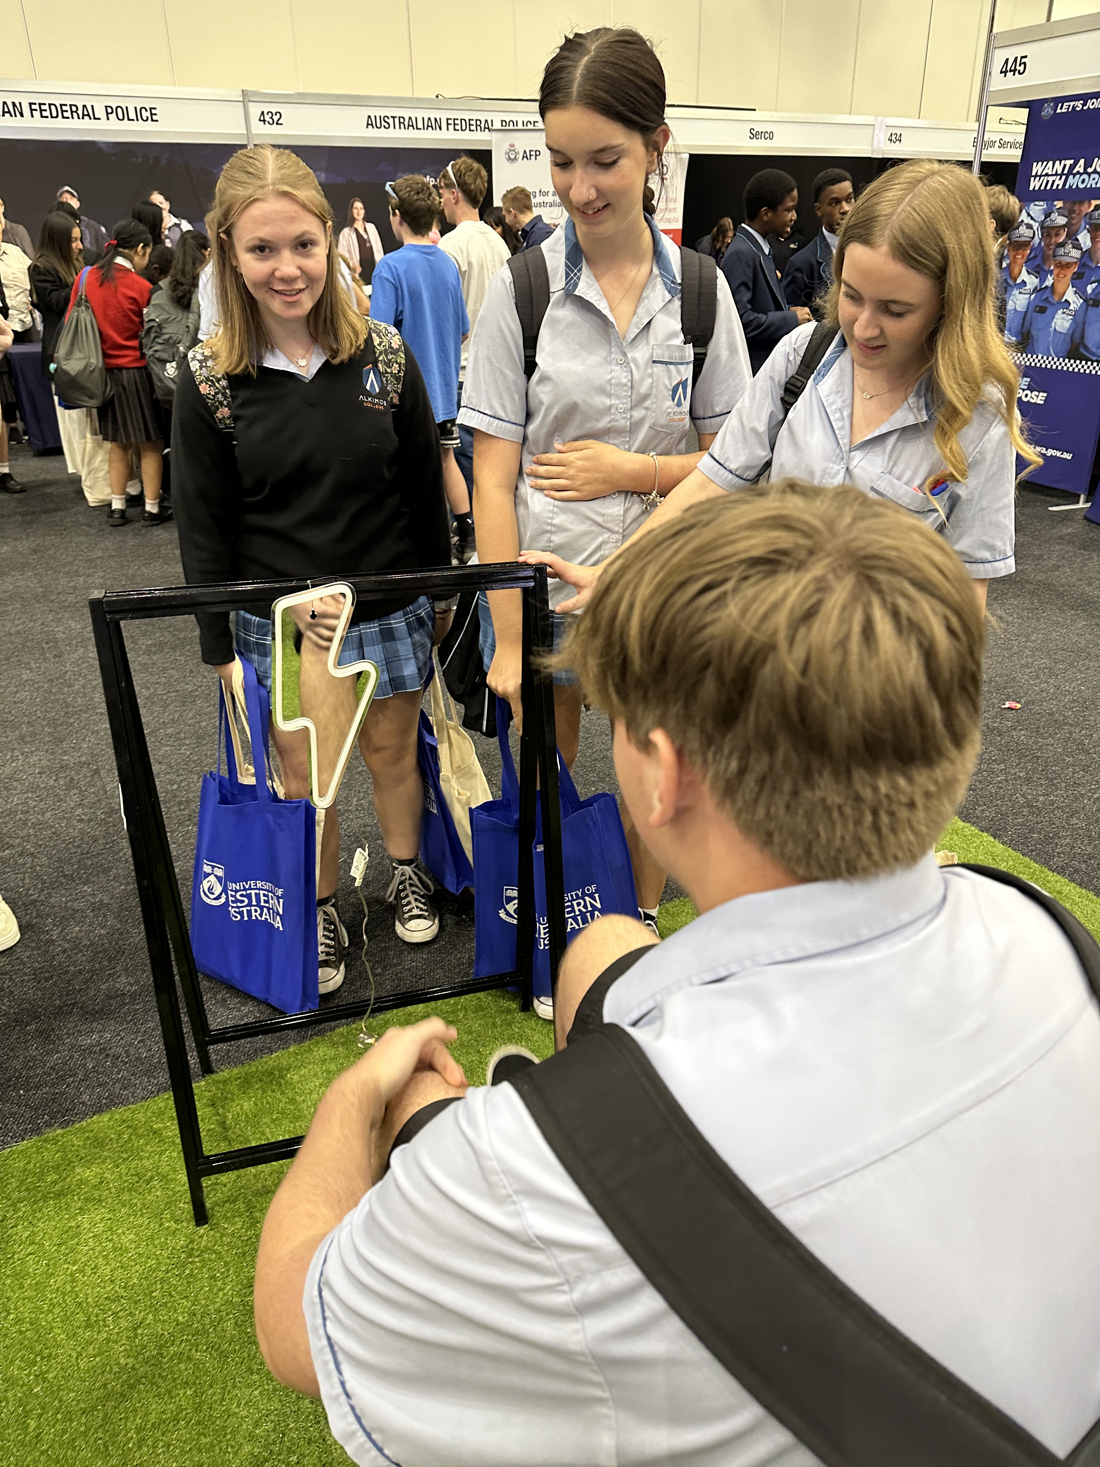
Achievement standard requirement
Students must achieve 14 C grades or higher (or equivalents) in Year 11 and Year 12 units, including at least six C grades (or equivalents) in Year 12 units.
Yr 11 (6 Subjects = 12 C’s)
Yr 12 (6 Subjects = 12 C’s)
Total=24 (Only need 14)
Notes:
Students must achieve 14 C grades (or equivalents) in Year 11 and Year 12 units, including at least six C grades in Year 12 units (or equivalents).
The achievement standard requirement can be met through ATAR, General, VET industry specific and Foundation courses.

Slide 9
Australian Tertiary Admission Rank (ATAR) courses
These courses:
are examined by the School Curriculum and Standards Authority (the Authority)
are used by the Tertiary Institutions Service Centre (TISC) to calculate a student’s Australian Tertiary Admission Rank (ATAR).
There are written examinations for all ATAR courses.
There are practical examinations for some ATAR courses. Students must complete both examinations in these courses.
Notes:
These courses are examined by the Authority (see Section 6 of the WACE Manual).
Student results in ATAR courses are used by the Tertiary Institutions Service Centre (TISC) to calculate a student’s Australian Tertiary Admission Rank (ATAR).
The ATAR is used to determine eligibility for university entrance.
Students seeking to achieve an ATAR will need to complete a minimum of four Year 12 ATAR courses, excluding unacceptable combinations (see Undergraduate Admission Requirements for School Leavers on the TISC website).
ATAR courses are for students who are typically aiming to go to university.

Slide 10
Completing ATAR courses
Students enrolled in a Year 12 ATAR course pair of units are required to sit the written and, if the course has one, practical examination.
Students who do not sit the examination will not:
have a course mark or grade recorded on their WASSA
receive an ATAR course report
have the pair of units completed in that year contribute towards any of the WACE requirements.
Notes:
Students who are enrolled in a Year 12 ATAR course pair of units are required to sit the ATAR course examination— even if they are only enrolled in one ATAR course.
There are both written and practical examinations for some ATAR courses.
Students who do not sit an ATAR course examination and do not have an approved sickness/misadventure application for that course, will not have the grades for the pair of units completed in that year contribute to the calculation of the Western Australian Certificate of Education (WACE).
This means, the grades for the ATAR Year 12 course will not contribute to the:
completion of a minimum of 20 units, including 10 Year 12 units
completion of at least one pair of Year 12 units from an English learning area course (if the ATAR Year 12 course was either English, Literature or English as an Additional Language or Dialect)
completion of one pair of Year 12 units from List A (arts/languages/social sciences) or List B (mathematics/science/technology)
achievement of at least 14 C grades or higher, including at least six C grades in Year 12 units
completion of at least four Year 12 ATAR courses.
Students who do not sit the ATAR course examination will not have a course mark or grade recorded on their Western Australian Statement of Student Achievement (WASSA), nor will they receive an ATAR course report.
As a consequence, a student may not meet the requirements to receive a WACE.
The Authority advises consultation with students who may be enrolled in ATAR course/s but who do not require an ATAR, to confirm that they must sit the examination for that course for it to contribute to their WACE.

Slide 11
General courses
These courses:
are not externally examined
have an externally set task (EST) which is set by the Authority
worth 15% of the marks
50 minute test
During Term 2
are designed for students who are typically aiming to enter further vocationally based training or the workforce directly from school.
Notes:
General courses are for students who are typically aiming to enter further vocationally based training or the workforce straight from school.
General courses may be used for alternative entry to some university courses. Information about alternative entry should be sought directly from universities.

Slide 12
VET industry specific courses
These courses:
include a full VET qualification and mandatory workplace learning
contribute towards the WACE as course units
qualifications undertaken through VET industry specific courses can be used to meet the Certificate II or higher component of the WACE
the workplace learning component of the course contributes as unit equivalents towards the WACE.
Notes:
VET industry specific courses include a full VET qualification and mandatory workplace learning. VET industry specific courses contribute towards the WACE as course units.
Qualifications undertaken through VET industry specific courses can be used to meet the Certificate II or higher requirement of the WACE. The workplace learning component of the course contributes as unit equivalents towards the WACE (see Section 4 of the WACE Manual for more detail).
VET industry specific courses are for students aiming to enter further vocationally based training or the workforce straight from school.
Some VET qualifications may be used for alternative entry to some university courses. Information about alternative entry should be sought directly from universities.

Slide 13
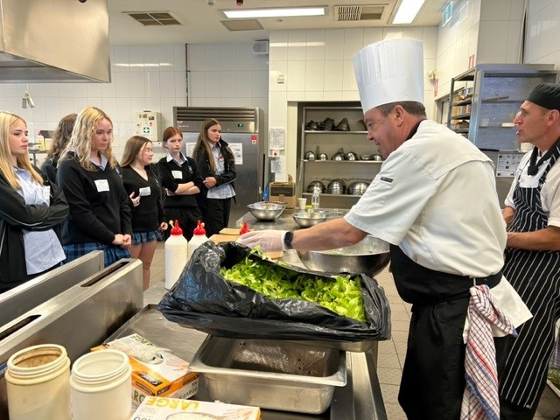
Vocational Education and Training (VET)
VET is nationally recognised and enables students to gain qualifications for all types of employment, and specific skills to help them in the workplace or in further training.

Slide 14
VET contribution to the WACE
As part of the minimum WACE requirements, a student may complete a Certificate II or higher in combination with ATAR or General courses.
Studying VET can provide up to eight units towards the number of course units students need to complete to achieve their WACE.
Students will typically enrol in five additional ATAR or General courses to meet the WACE requirements.

Slide 15
Changing courses in Years 11 and 12
The Authority publishes dates about changing enrolments in its Activities Schedule.
There are points in the semester after which students should not change courses because it would be unlikely they could complete the assessment program.
The date in 2024 was the 3 May.
Notes:
The Activities Schedule is published on the Authority website.

Slide 16
Literacy and numeracy standards
Meeting these standards:
is a benchmark of educational achievement
is valued by employers and post-school training providers
ensures all students leave school with the best chance of future success.

Slide 17
OLNA disability adjustments
Adjustments will be made to the OLNA conditions, if a student’s access to the assessment is significantly affected by a disability, impairment, illness or impediment.
Evidence of a disability, diagnosed by a specialised medical professional, is required for adjustment.
The Guidelines for equitable access for assessments is available on the Authority website at https://senior-secondary.scsa.wa.edu.au/assessment/disability-adjustment-guidelines.

Slide 18
OLNA — Typical adjustments
Adjustments typically requested for approval by principals include:
rest breaks and provision for a pause button
extra time to work
a reader
scribe assistance for the writing component
use of a support person for the reading and numeracy components
special formats.

Slide 19
Support — Literacy and numeracy standard
Assistance is available through:
feedback to schools on individual student performance for each OLNA component.
olna.com.au

Slide 20
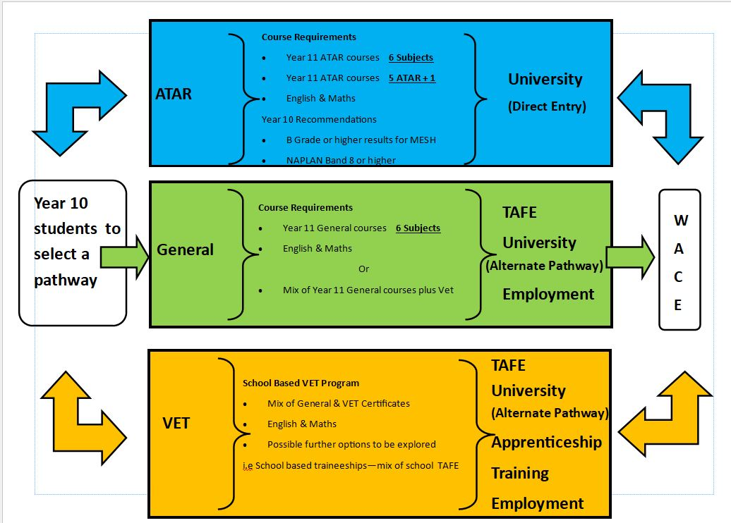

Slide 21
ATAR Pathway

Slide 22
General Pathway

Slide 23
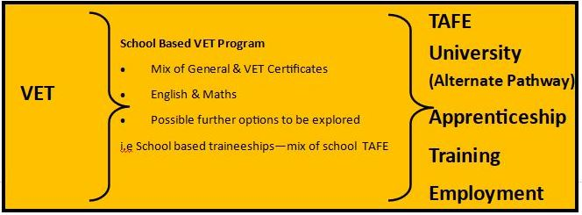
VET Pathway

Slide 24
The courses our school is offering – 15 ATAR Courses
List A | List B
English Economics Modern History Media Production & Analysis Visual Art | Biology Chemistry Engineering Studies Human Biology Maths Applications Maths Methods Maths Specialist Physics Physical Education Psychology
<<school to insert>>

Slide 25
The courses our school is offering – 17 General
List A | List B
Ancient History Career & Enterprise Children, Family & the Community English Media Production & Analysis Music Visual Art | Building & Construction Food Science Health Studies Human Biology Materials – Wood Maths Essentials Outdoor Education Physical Education Psychology Science in Practice

Slide 26
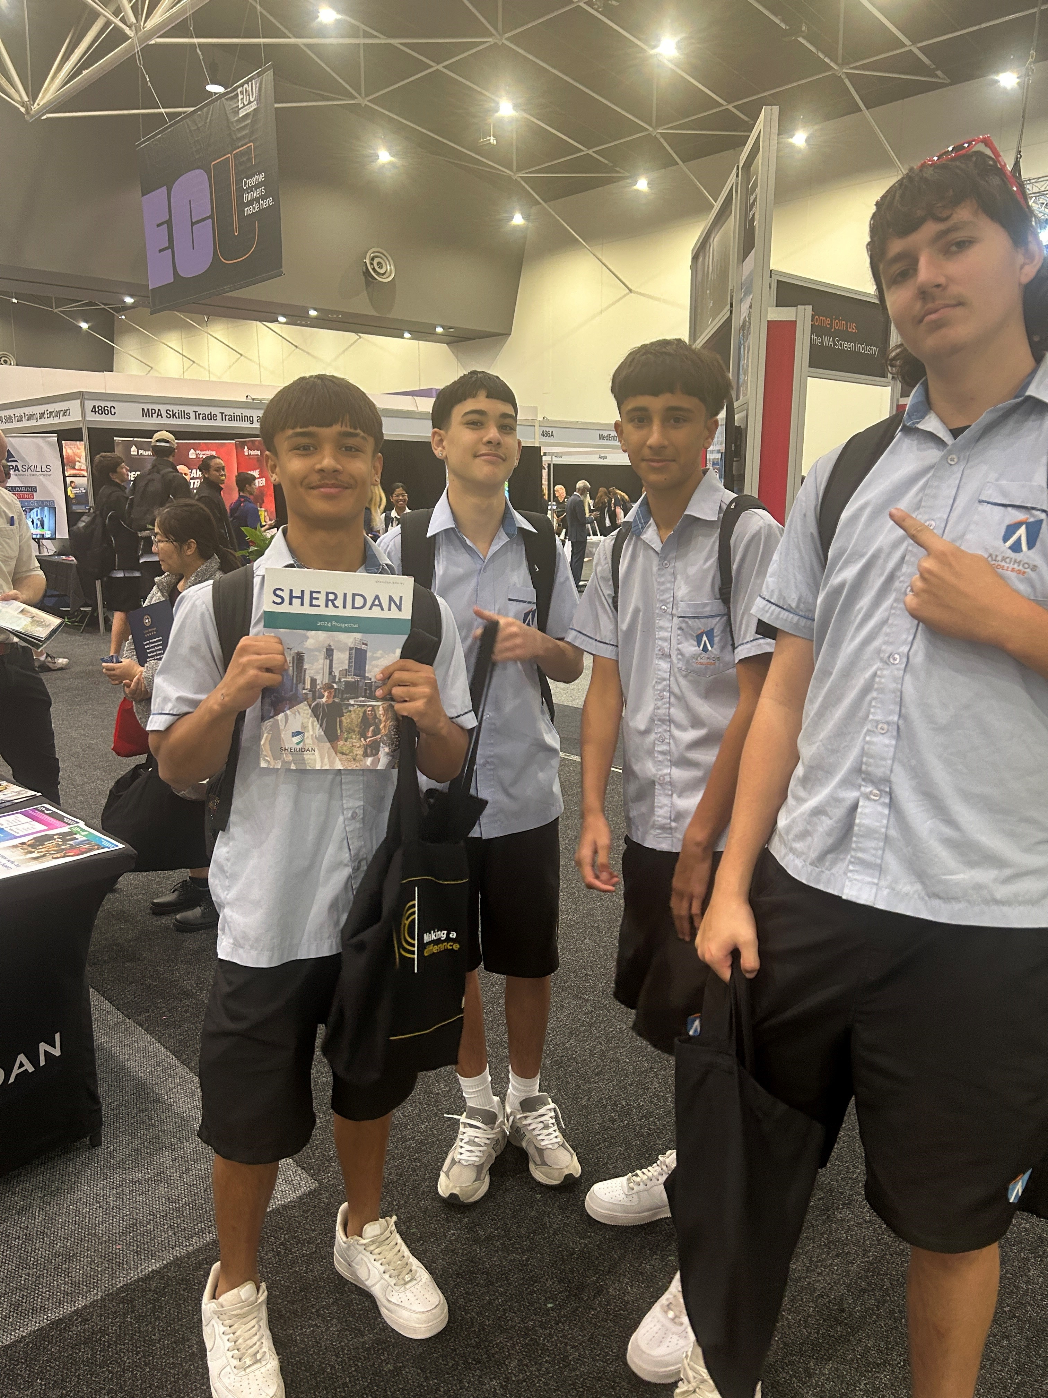
The courses our school is offering – 5 VET Courses
VET Courses
Certificate II in Sports Coaching Certificate II in Workplace Skills Certificate II in Creative Industries (Media) Certificate II in Hospitality Certificate II in Retail Cosmetics

Slide 27
WACE Checker
The WACE Checker is a tool that Year 12 students can use to check their progress towards meeting the requirements of the WACE.
It is designed to determine whether students have met (or are expected to meet) each of the requirements for the WACE.
The WACE Checker is easy to use.
Students can also check ATAR progress via online ATAR prediction tools. We also monitor and check progress.

Slide 28
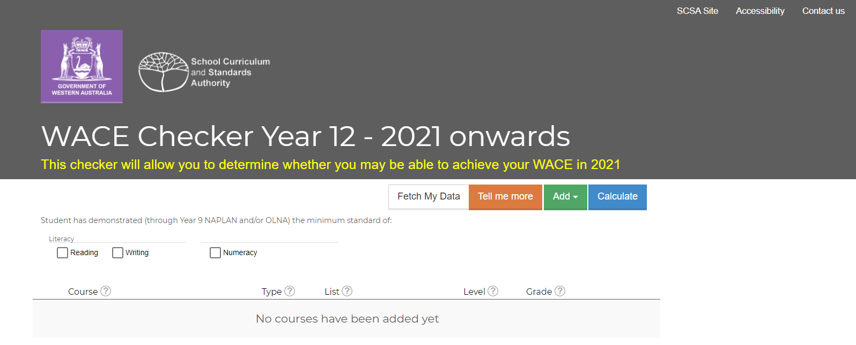
WACE Checker – Start Screen
Notes:
We encourage schools to share awareness of the tool with their Year 12 students.
Students can use it at home with their parents, or at school in conjunction with year coordinators or school admin staff if they are considering making changes to their education program.
There is a shared responsibility with the school and the student to ensure students remain WACE eligible should they make changes to the learning program and/or to monitor their grades.
Students enter information about their enrolments and achievements, the WACE Checker generates a report that shows progress towards WACE achievement.
Students can save the information, print it, email it to one or more people and if required, access the information at a later date to make changes.
For example, every year, students do not achieve their WACE because they don’t have a List B subject, or enough unit equivalents. This could be avoided by using the WACE Checker if students are seeking to make changes to their education program that may affect their WACE achievement.

Slide 29
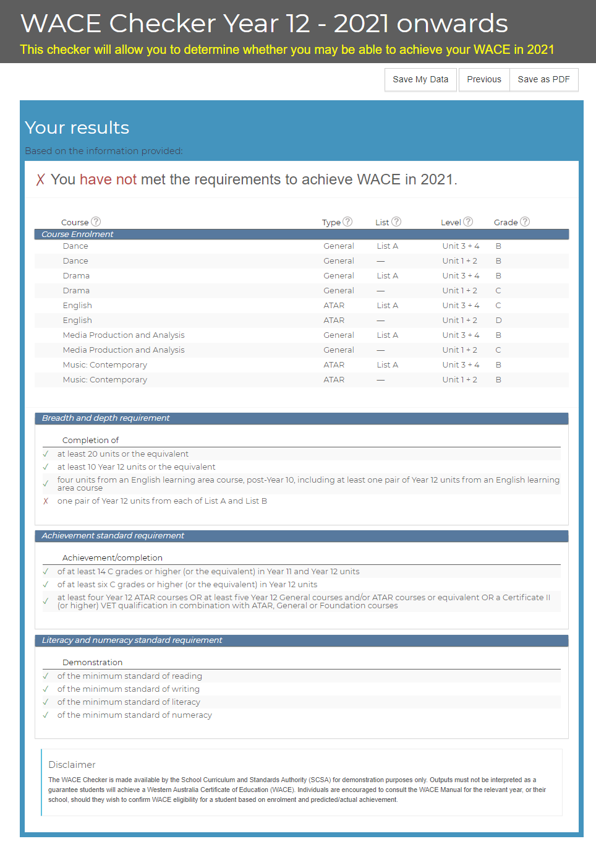
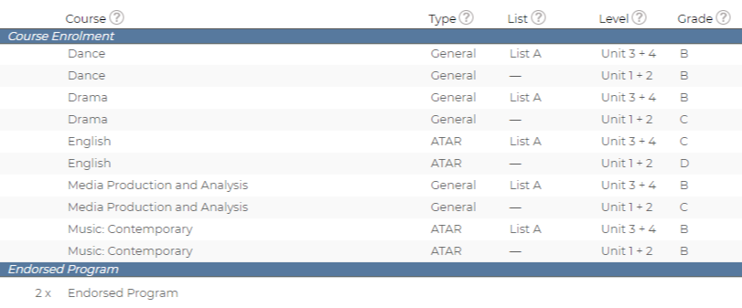
WACE Checker – Summary

Slide 30
Information for students

Slide 31
Websites for students and parents
Notes:
Student Information website
The student site provides students with easy access to information under the headings of:
Student Portal
Getting Organised
Curriculum
Examinations and Texting
Certification and Post-School
Frequently Asked Questions (FAQs).
The student site currently focuses on Year 12s and links closely to the Year 12 Information Handbook 2020, Part I. The handbook is available at https://www.scsa.wa.edu.au/publications/year-12-information.
Parents and Community website
The Parent and Community website can now be accessed on the Authority website https://www.scsa.wa.edu.au via the Parents and Community tab.
The parent site provides information about what children and young people should learn, how they are assessed and the standards they are expected to reach at each year level, from Kindergarten to Year 12. The site will continue to be refined and developed over time.
The parent site has been developed for parents and community members as a guide to:
the Western Australian Curriculum and Assessment Outline (the Outline), Kindergarten through to Year 10
the Western Australian Certificate of Education (WACE), Years 11 and 12.
Parents and the community can access information about:
what children and young people should learn
how they are assessed
the standards children and young people are expected to reach at each year level.

Slide 32
Links
 | www.scsa.wa.edu.au
 | info@scsa.wa.edu.au
 | https://facebook.com/SCSAWA
e

Slide 33
PHASE 3 - Course Counselling
Each student will have a copy of the following:
Student Handbook 2025
Course Selection Tools 2024
Individual Student Table

Slide 34
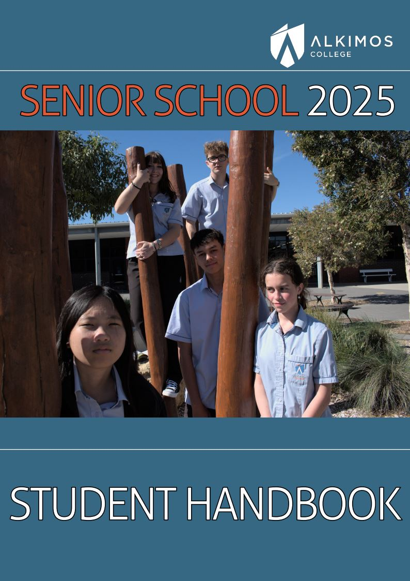
Student Handbook
Your student handbook includes all the information you will need to prepare you for the ‘Course Counselling’ process. It includes:
Everything that has been covered in this presentation
Details relating to fees and charges
Information about TISC and Exams
Course information
Assessment Policy
and more

Slide 35
Course Selection Tools 2023
The ‘Course Selection Tools’ booklet is designed to guide you through the process of selecting your courses. It includes:
Course Selection Preparation activities
Estimated Subject costs 2025
Suggested Pathways
Course Selection sheet
WACE Requirements
Career contacts

Slide 36
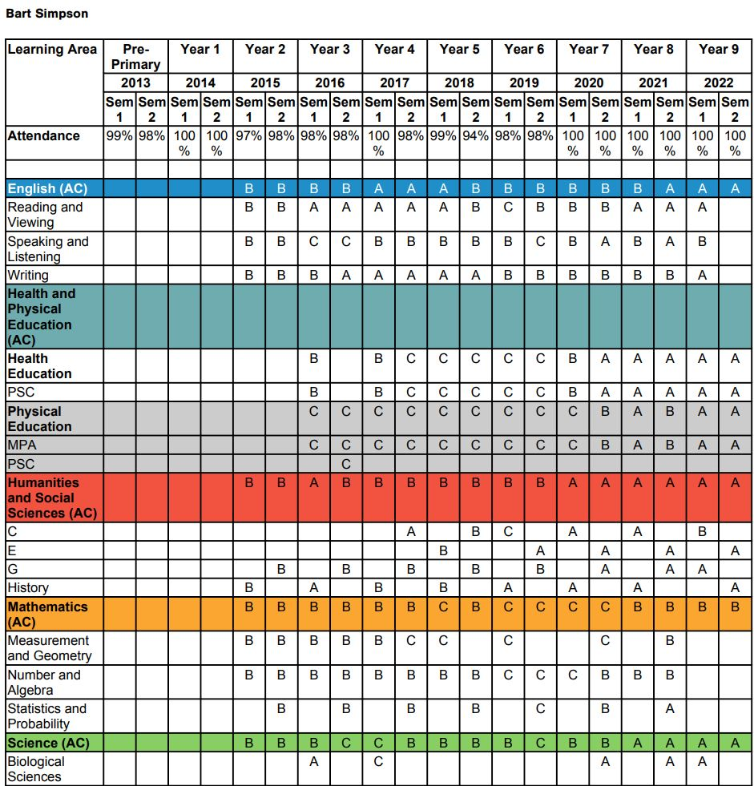
Individual Student Table
The ‘Individual Student Table’ is a
record of student grades from
Year 1 through to the end of Year 9, in
all the subjects they have taken.
This can be used as a guide to see
whether a student is eligible for a
course or not.

Slide 37
PHASE 3 - What happens next?
A message will be sent to all parents via Compass/Connect in relation to the Course Counselling booking process
Once this is set up, parents can go online and book an appointment with a staff member. You will be invited to start making your bookings soon
All the materials you see today will also be available on our school website to view or download
We will also make a weekend available for parents who can’t make it during the week. (Super Subject Selection Saturdays) 15 June 2024

Slide 38
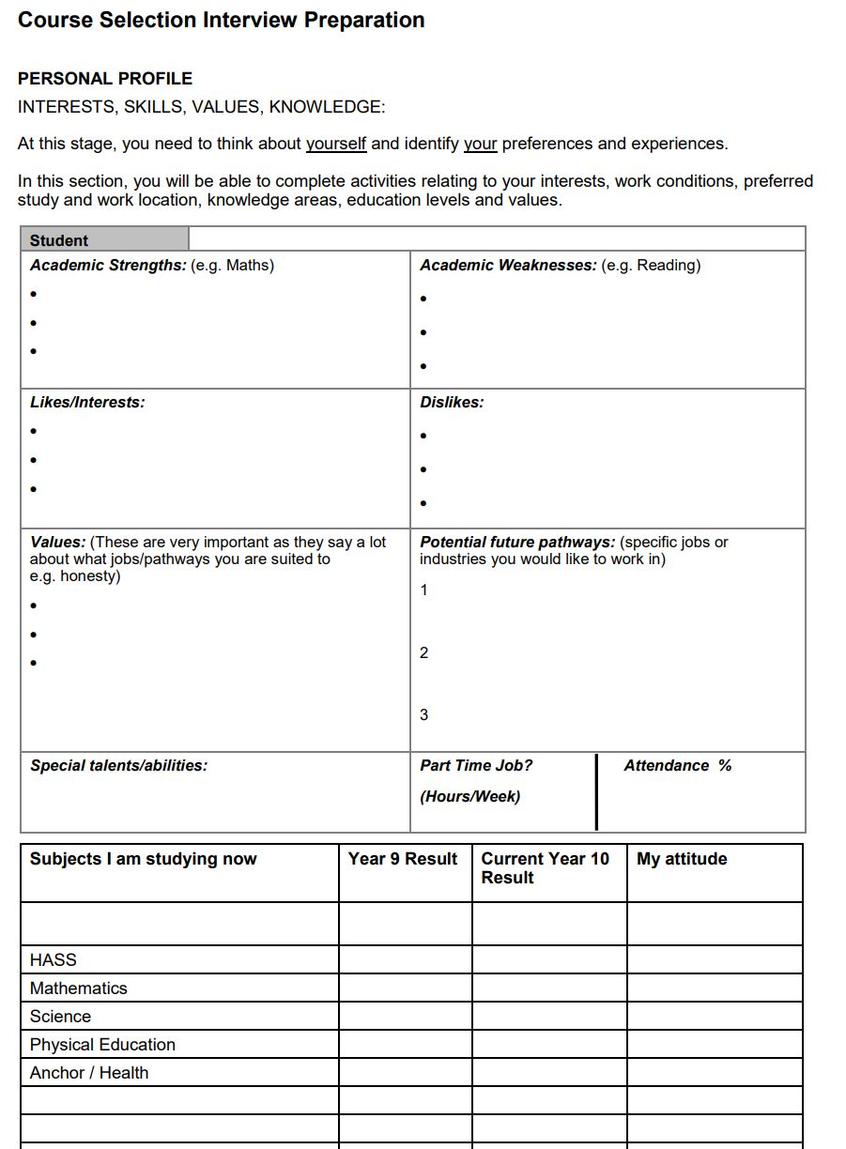
Course Preparation
Each appointment is up to 30
minutes in length. Students need
to come to the appointment with
the ‘Interview Preparation’
section completed
Students will complete this section in their HASS classes
next week. Their HASS teachers will let them know when
they need to bring them in.
Copies of all the materials will also be available on the
Year 10 –CONNECT page as well as other useful
resources

Slide 39
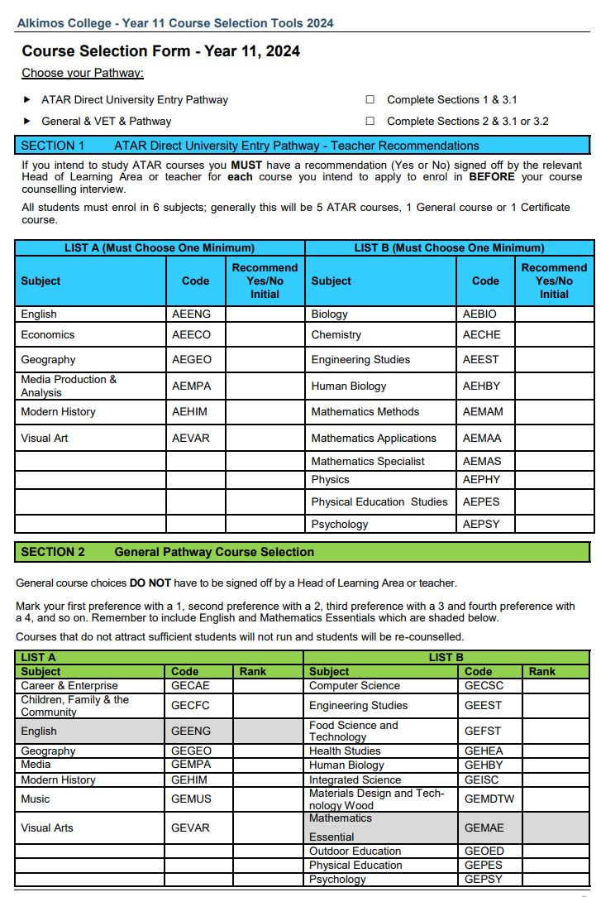
Course Selection Form
Students doing ATAR will need to get a
recommendation from their teacher or
HOLA.
General and VET students do not need
recommendations from teachers. Instead,
they can rank their preferences of subjects
in preparation for their interview

Slide 40
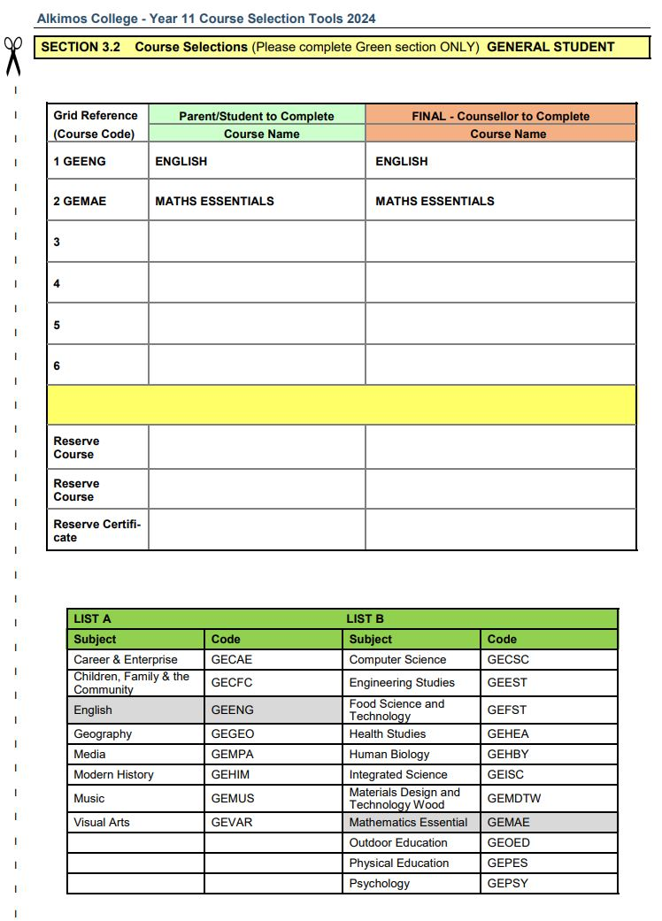
Course Selections Form
Students are to place their selections into
the ‘green’ column. Some selections have
already been pre-filled.
Students should also select 3 reserve
courses
Staff will fill in the ‘red’ column once all
selections have been made

Slide 41
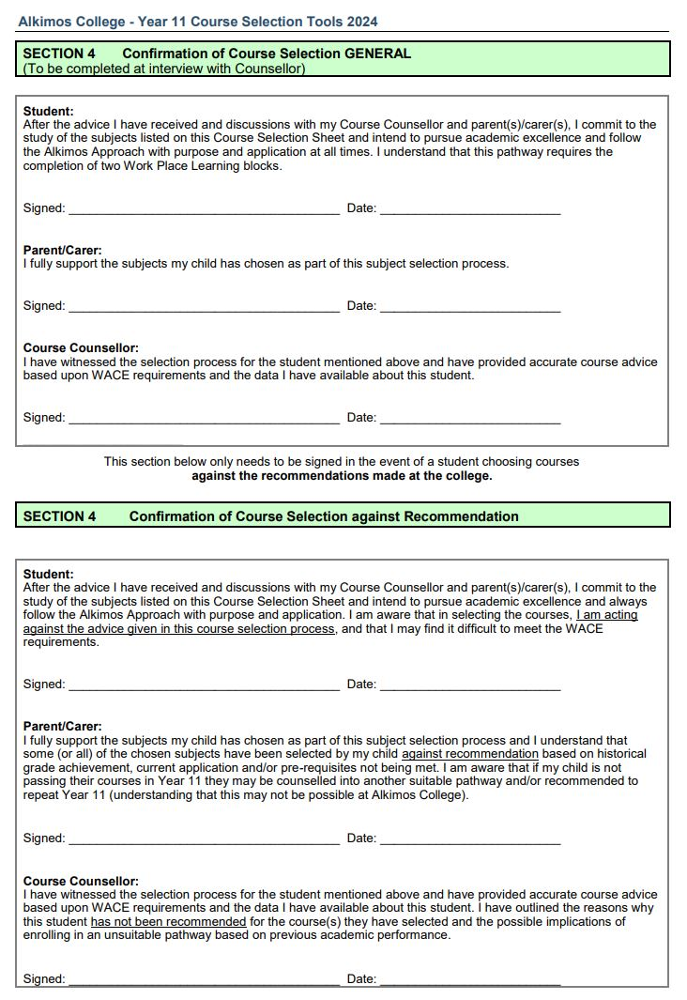
Course Agreement Form
Once the course selections have been
made, student, parent/carers and staff
member will sign the confirmation of
course selection form. This is a
commitment from the student to pursue
academic excellence and follow the
Alkimos Approach.

Slide 42
Once the course counselling process is completed, staff will return the signed forms and selections to Mr Hatzis who will input the data into the timetable.
If a subject does not run due to insufficient numbers, a student will be counselled into another subject.
Students will receive confirmation of courses they’ve selected once the timetable is complete.

